Slide 1
The Key to the German Market
Key Factors for the Metal and Engineering Industry
Olaf Holzgrefe | Head of Intern. Business Development | BME

Slide 2
GERMANQualitySourcing – The Key to the German Market Key Factors for the Metal and Engineering Industry
1. The BME … in plain words 2. Economy and Purchasing … Developments in Germany … In Mechanical and Engineering Industry 3. Purchasing Standards - Quality and Compliance … Key Factors for Metal and Engineering Industry
4. GERMANQualitySourcing – The Bridge to Germany … Q & A

Slide 3
GERMANQualitySourcing – The Key to the German Market Key Factors for the Metall and Engineering Industry
1. The BME … in plain Words 2. Economy and Purchasing … Developments in Germany … In Metall and Engineering Industry 3. Purchasing Standards - Quality and Compliance … Key Factors for Metall and Engineering Industry
4. GERMANQualitySourcing – The Keyto Germany … The Quality Initiative of the BME

Slide 4
1. The BME – in short words
Services
People
Processes
Network

Slide 5
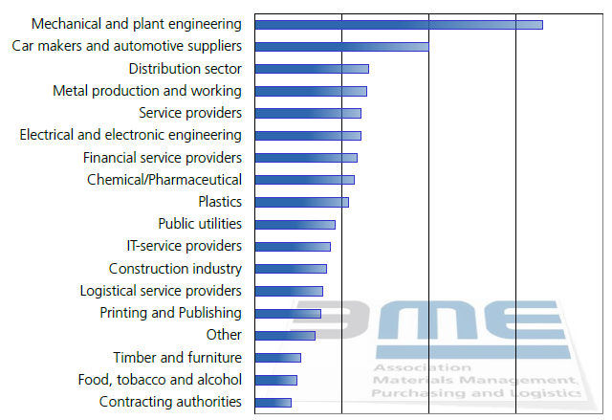
1. The BME – in short words
BME Basics
1.250 billion Euro purchasing volume
9,000 private- and corporate members;
+1,800 companies
100.000 buyers in BME companies

Slide 6
1. The BME – in short words
BME Basics
1.250 billion Euro purchasing volume
9,000 private- and corporate members;
+1,800 companies
100.000 buyers in BME companies
BME member structure: 67 % = Manufacturing 50% = SMEs (between 1.000 to 10.000 employees)
6% = TOP-200 and DAX companies with over 10.000 employees
6

Slide 7
Purchasing Network And Informationprovider
Know-how transfer for buyers, trainings and seminars for buyers, Supply Chain Manager and Young Professionals
People
Information and services for buyers and companies i.e. Benchmarks, German PMI (EMI), Guidelines, Compliance …
Services
40 expert groups and process standardisation i.e. BMEcat, eCl@ss, Reproc …
Processes
Congresses, fairs and events - i.e. BME-Symposium, Partner of Hanover Fair, Supplier Dialogue, China Platform …
Network

Slide 8
1. The BME – in plain words
BME Structure
Over 30 Focus Groups
41 regions with 400 own events per year: local contact
Sections
Logistics: with working groups
Procurement service providers: with professional groups
Public Procurement with reference model „REPROC“ (aided through the German Federal Ministry of Economics and Technology)
• Fleet Management
• Procurement: Raw materials
• Employees in procurement
• Financial service providers
• Marketing and consultant procurement
• Energy
• Low cost country sourcing
• Project procurement
…and many more

Slide 9
1. The BME – in plain words
BIP - Best in Procurement
BME Products & Services
Magazine for manager in procurement and logistics
Made by BME – for 8,000 BME members and selected decision makers for free
Print run:15,000
Markit/BME Purchasing Managers Index (EMI)
Online newsletter (monthly) (news, trends, events)
Studies, guidelines, checklists, specialist shop
Magazines (Beschaffung aktuell, BizTravel)
Portal www.bme.de
Platform China (BME China)

Slide 10
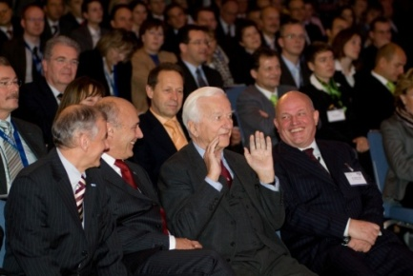
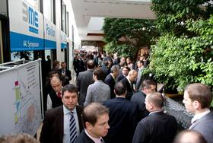
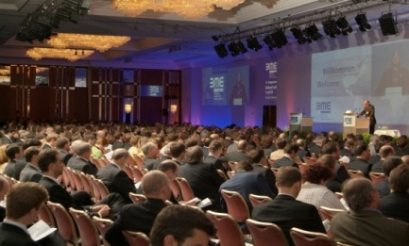
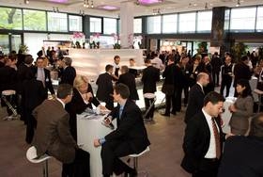
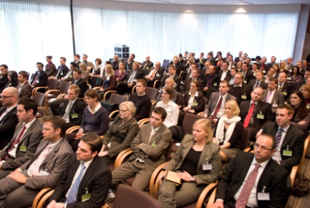
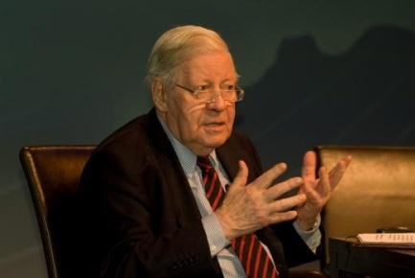
1. The BME – in plain words
Seminars &Trainings
BME Symposium
Over 500 purchasing and logistics events
Seminars
Management forums
Inhouse training courses
Pre-examination courses
Final examinations leading to relevant qualifications specialist purchasing and logistics officer (Chamber of industry and commerce/BME)
Largest event of its kind in Europe
Over 2,200 participants from all branches of industry
18 parallel conferences
Focus events
150 speakers
100 service providers
Evening events
Conferment of the „BME Innovation Award”)

Slide 11
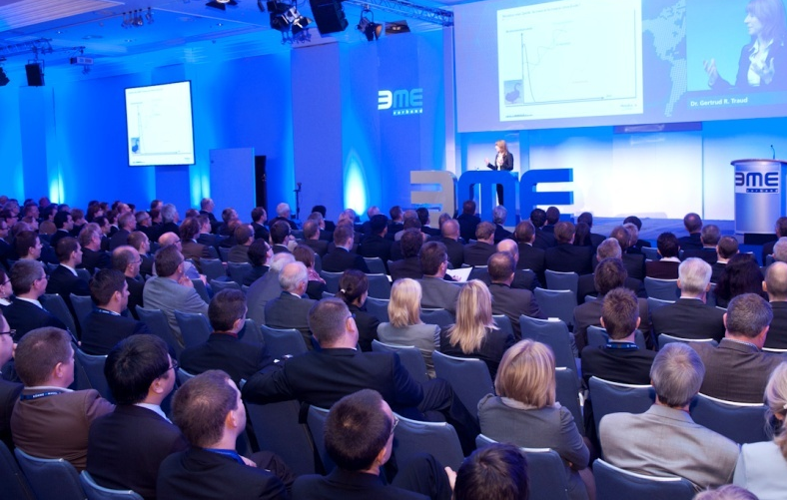
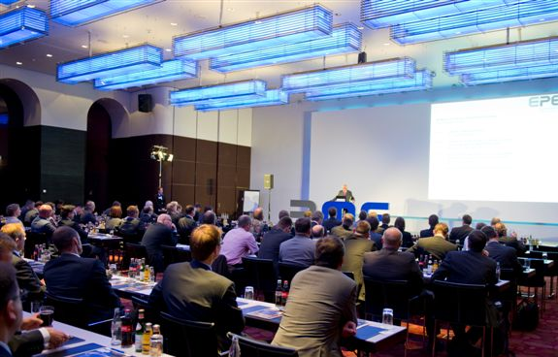
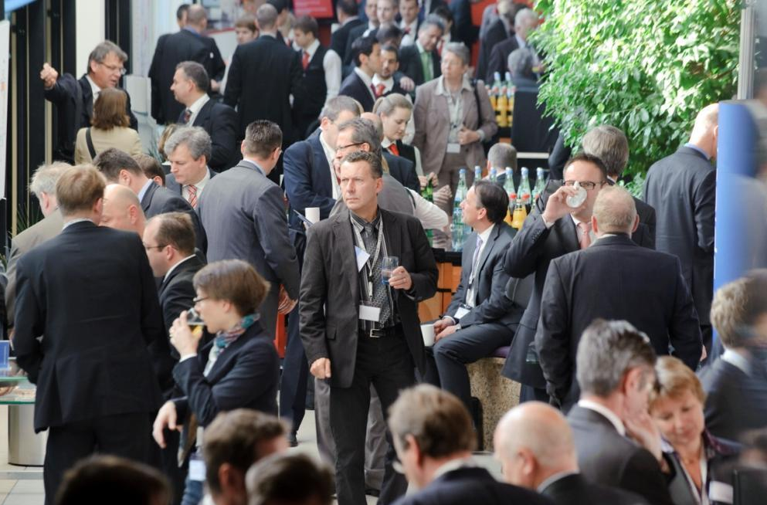
1. The BME – in short words
Highlights: BME-Symposium – largest purchasing congress in EU 2.250 participants | 2012: 7th-9th November, Berlin
eLösungstage – largest eProcurement-congress 1.000 participants | Duesseldorf
EPE – European Procurement Excellence CPO and CFO event | 2012: 21th-22th June, Munich
BME Symposium 2011 – 2.250 Buyer
EPE Munich 2011 – 400 CPOs & CFOs
Enter the BME-Network and become a Partner Use BME as a Marketing platform booth at BME-Symposium Fair, Advertisement in BIP-Magazine or BME-Newsletter
Ask for Matchmakings, Trainings- and Seminars
Former German Chancellor H. Schmidt
BME Symposium 2011 – Networking

Slide 12
GERMANQualitySourcing – The Key to the German Market Key Factors for Metal and Engineering Industry
1. The BME … in plain words 2. Economy and Purchasing … Developments in Germany … In Metal and Engineering Industry 3. Purchasing Standards - Quality and Compliance … Key Factors for Metal and Engineering Industry
4. GERMANQualitySourcing – The Key to Germany … Q & A

Slide 13
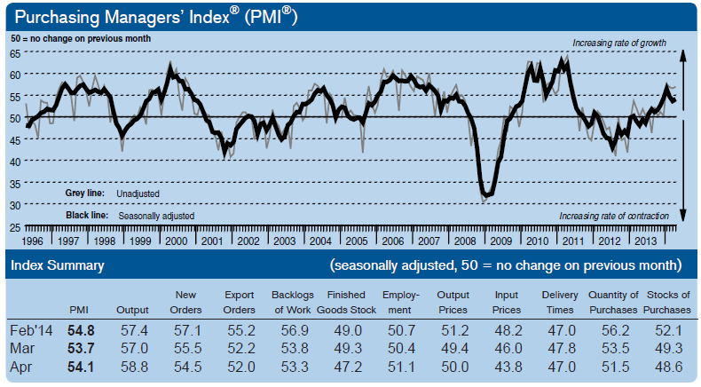
2. Economy and Purchasing

Slide 14
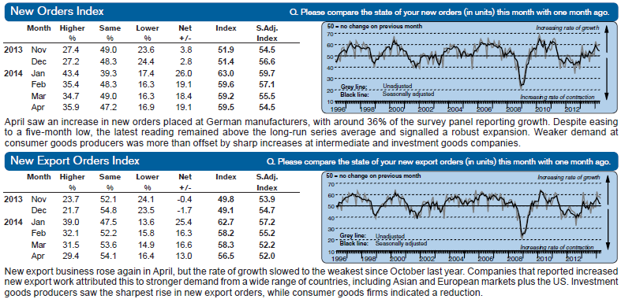
2. Economy and Purchasing

Slide 15
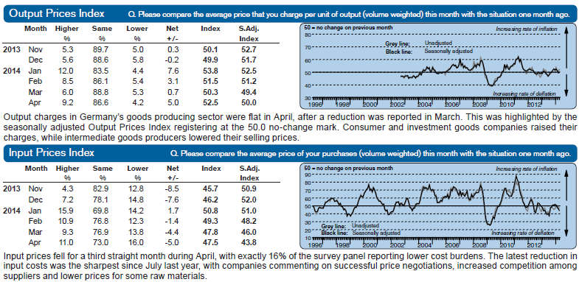
2. Economy and Purchasing

Slide 16
2. Economy and Purchasing
Procurement Markets for German Buyers
Source: BME-Member Survey, 11/2011
1. Europe (95%) remains most important market, followed by China (77%) 2. Eastern Europe is still in interesting (76%) 3. India becomes stronger

Slide 17
2. Economy and Purchasing
TOP Export Countries EU – Germany – Italy 2012
© Statistisches Bundesamt, Wiesbaden 2012
© Statistisches Bundesamt, Wiesbaden 2013

Slide 18
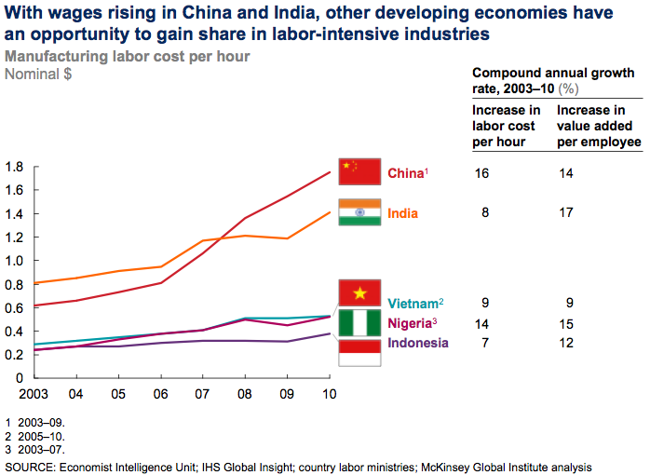
2. Economy and Purchasing

Slide 19
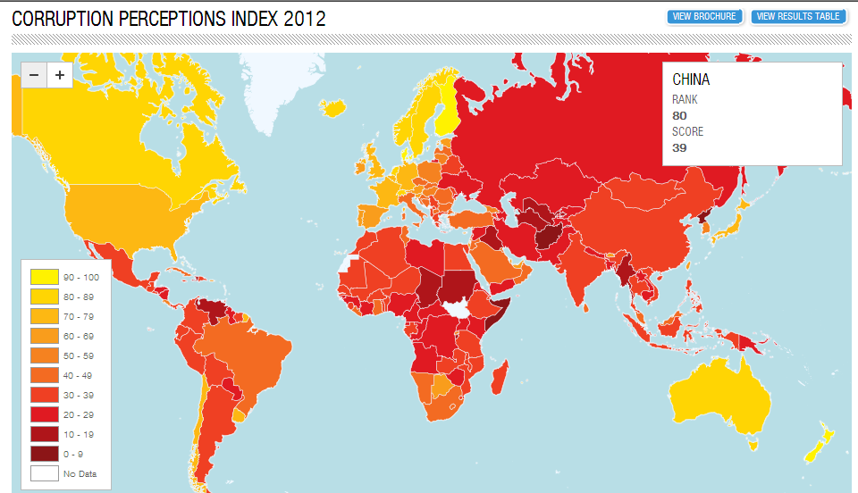
2. Economy and Purchasing
Quelle: Transparency International

Slide 20
2. Economy and Purchasing
The question
10
Emerging country, technology lower than EU
High standards Low risks
5
Attractivness of the county
Low development in economy high risks
Higher country risks But lower prices
5
10
Attractivness of purchasing
Quelle: Dr. Raymund Aich / BME Der Einkauf 2015

Slide 21
GERMANQualitySourcing – The Key to the German Market Key Factors for the Metal and Engineering Industry
1. The BME … in short words 2. Economy and Purchasing … Developments in Germany … In the Metal and Engineering Industry 3. Purchasing Standards - Quality and Compliance … Key Factors for the Metal and Engineering Industry
4. GERMANQualitySourcing – The Key to Germany … Q & A

Slide 22
3. Purchasing Standards
Supplier Relationship Management: Critical Success Factor
1. Over 55 % of the costs are for materials, bought-in goods and services
The focus of the supply managers = Balancing the magic triangle:
3. The aim is: → to optimize the total costs of ownership (TCO) → to have strong and reliable supply chains → with stable processes and risks under control
Quality
Reliability
Price

Slide 23
3. Purchasing Standards
Trends in Supplier Relationship Management
1. Innovative suppliers
Professional quality assurance
Sustainability / compliance
3. Total Cost of Ownership / Intelligent cost engineering
Improving visibility and coordination in the supply chain
Flexibility, reliability and non-disruptive production
The key trend
COLLABORATION within the supply chain.
!

Slide 24
3. Purchasing Standards
Be Responsive to the Quality Sourcing Process of Your Customer
1. Formal supplier evaluation process
identifying potential suppliers
Request of quality certificates and compliance informations
→shortlist of 2/3 candidates
→visiting the preselected suppliers
→deciding on first and second source
→contracting
2. Formal process of dealing with quality complaints
3. Formal process of supplier audits and risk analysis

Slide 25
3. Purchasing Standards
Be Responsive to the Quality Sourcing Process of Your Customer
1. Formal supplier evaluation process
identifying potential suppliers
Request of quality certificates and compliance informations
→shortlist of 2/3 candidates
→visiting the preselected suppliers
→deciding on first and second source
→contracting
2. Formal process of dealing with quality complaints
3. Formal process of supplier audits and risk analysis
1. Formal supplier evaluation process
identifying potential suppliers
Request of quality certificates and compliance informations
→shortlist of 2/3 candidates
→visiting the preselected suppliers
→deciding on first and second source
→contracting
2. Formal process of dealing with quality complaints
3. Formal process of supplier audits and risk analysis
Your key to success
Make your quality, sustainability and reliability visible
!

Slide 26
3. Purchasing Standards
Inside German Companies - Developments
More collaboration between purchasing and R&D
Reduce risks in material management → flexiibility
Critical fields: Raw materials
Cost pressure and volatile markets
Growing exchange rate exposure

Slide 27
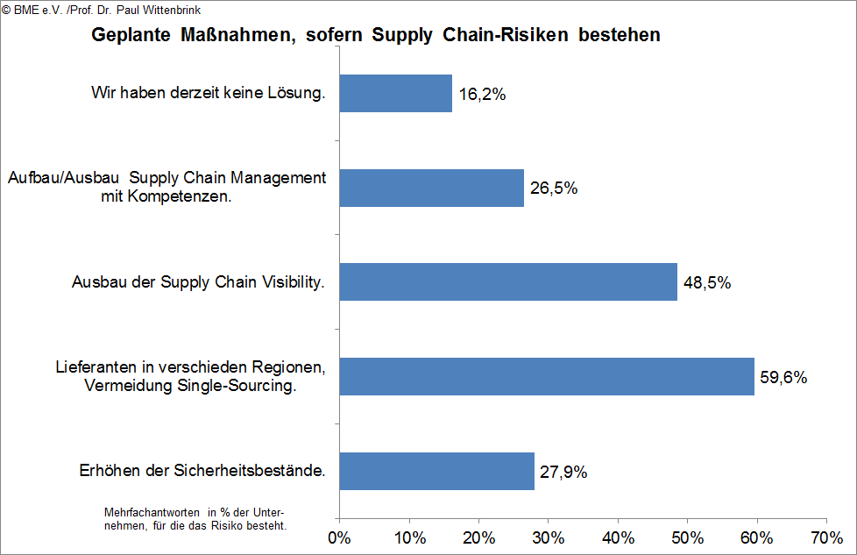
3. Purchasing Standards
Strategies 2015 – Reduce of risks inside the intern. Supply Chain?

Slide 28
GERMANQualitySourcing – The Key to the German Market Key Factors for the Metall and Engineering Industry
1. The BME … in short Words 2. Economy and Purchasing … Developments in Germany … In the Metal and Engineering Industry 3. Purchasing Standards - Quality and Compliance … Key Factors for the Metall and Engineering Industry
4. GERMANQualitySourcing – The Key to Germany … Q & A

Slide 29
BMEnet GmbH (a BME e.V. subsidiary ) BME e.V. (AMMPL) Bolongarostr. 82 D – 65929 Frankfurt / Main Phone: +49 (0)69 – 308 38 343
Fax: +49 (0)69 – 308 38 189 Mail olaf.holzgrefe@bme.de
Olaf Holzgrefe Head International Business Development

